Slide 1
Making Informed Predictions of Pavement Life and Life-Cycle Emissions
How Carbon Budgets for Pavement Maintenance might evolve..
Allan Ogwang

Slide 2
Literature review
The outlook of pavement management decisions have been purely economic; as the user costs tend to increase with the deterioration of road condition. NCHRP Report (2012), Washington DOT Report (2010)
Lutsey and Sperling, 2009 expounds on importance of pavement in GWP for Transportation sector
Santero and Horvath 2009, Sathaye et al. 2010, Lidicker et.al 2013. Incorporation of GHGs emissions as part of the pavement management decision policy criteria in the transportation sector

Slide 3
Motivation
IPCC; not more than I trillion tons of Carbon can be released to end of century to maintain the warming below 3.6ºF
[by 2011, 469 billion tons of the carbon budget left till the end of the century. ]
Transportation emissions contribute 14% of the global emissions and 28% in the US [EPA, 2014]
California AB32, emissions budget not unprecedented.

Slide 4
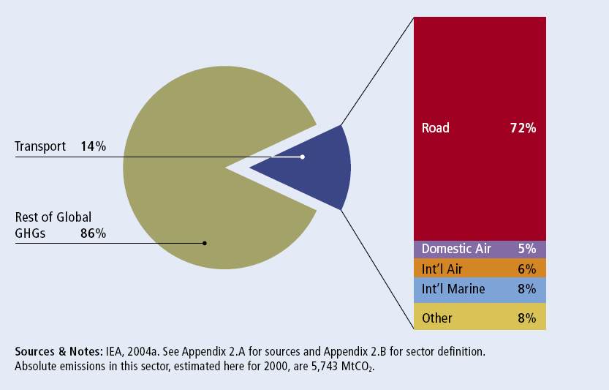
Motivation

Slide 5
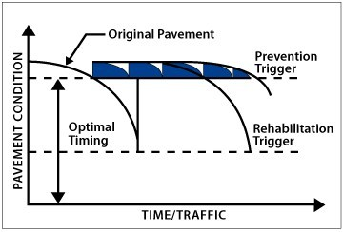
Pavement Management
Source: Franklin Pavement Management, LLC. <http://www.franklinpavement.com/pavement-management.html>

Slide 6
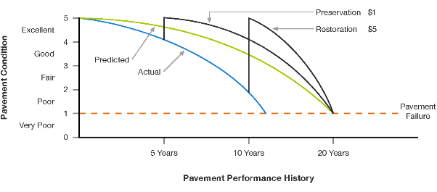
Pavement Mgt
Source: Agile Assets, “Pavement Management, an Important Validation of the Pavement Performance Concept”

Slide 7
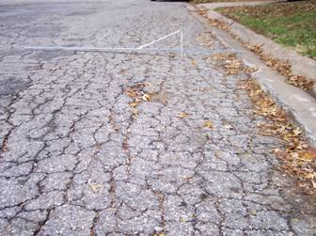
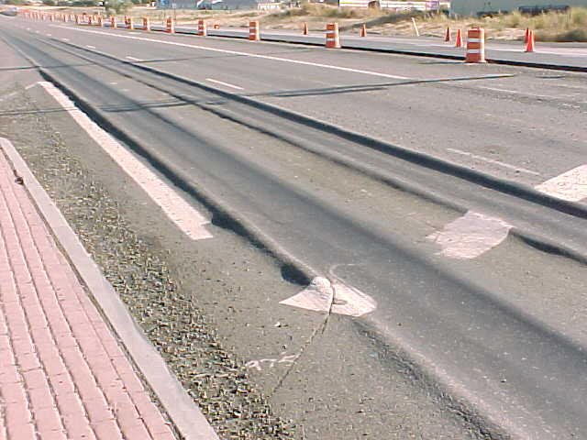
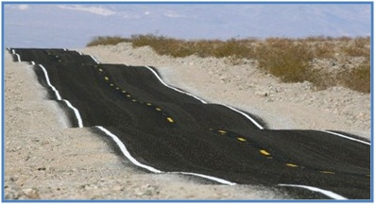
Pavement Distresses
Cracking
Rutting
Roughness

Slide 8
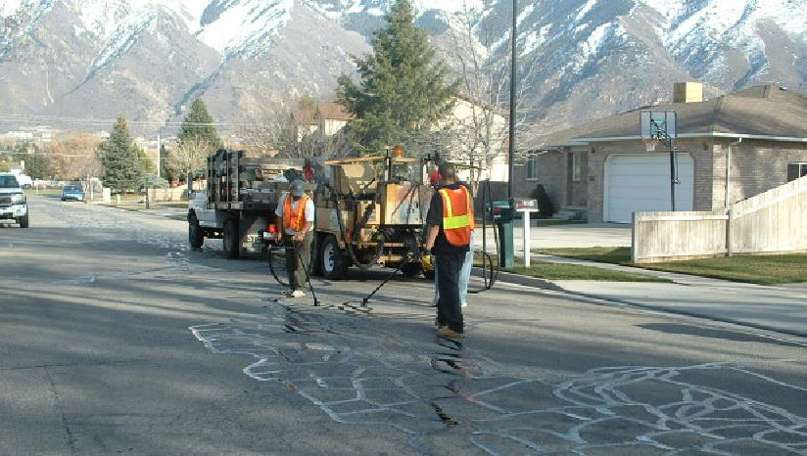
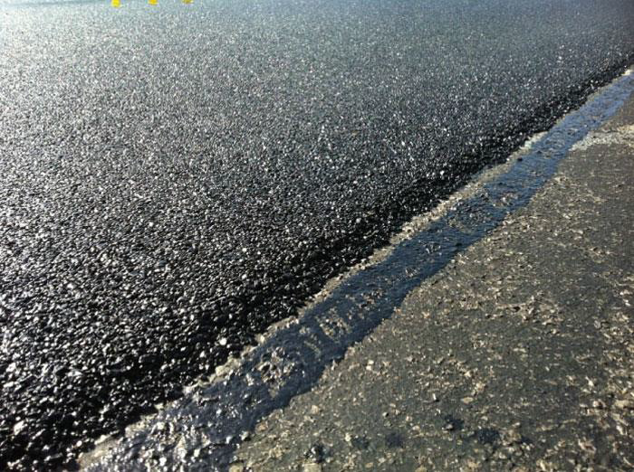
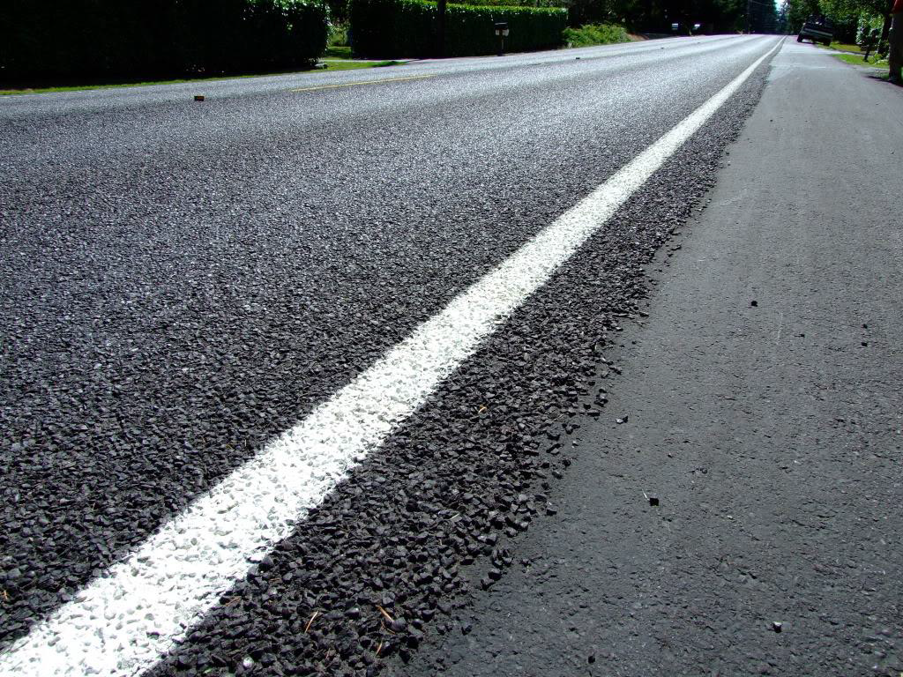
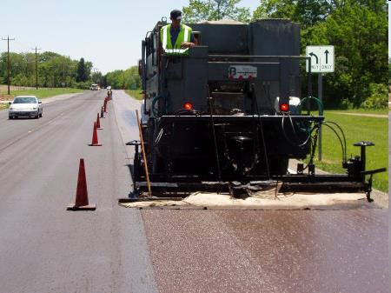
Asphalt Pavement Preservation Treatments
Thin Overlay
Crack seal
Chip Seal
Slurry Seal

Slide 9
Why care?
Source: Hao Wang, “Life Cycel Assessment of Asphalt Pavement Preservation.”

Slide 10
Case Study: Washington State PMS
State legislature has established the ‘Pavement Preservation Program’
WSDOT plans for preservation of road network based on rehabilitation needs (resurfacings) for short and long term (10 years).
Three basic pavement types:
Asphalt (resurfacings frequency: 11-17 yrs)
Chip seal (6-8 years)
Concrete Pavement (50 years)
Notes:
The mission of the Preservation Program is: “To maintain, preserve, and extend the life and utility of prior investments in transportation systems and services.” (RCW 47.04.280).

Slide 11
WSDOT PMS
What triggers rehabilitation?
Cracking?
Rutting?
Roughness?
Knowledge of the above determines frequency of overlay
Notes:
History has shown that the condition indicators that “trigger” rehabilitation are usually the cracking and rutting indices (described in Section 3.1). This is because roughness tends to be a lagging indicator that appears later because the road was not rehabilitated when it was Due.

Slide 12
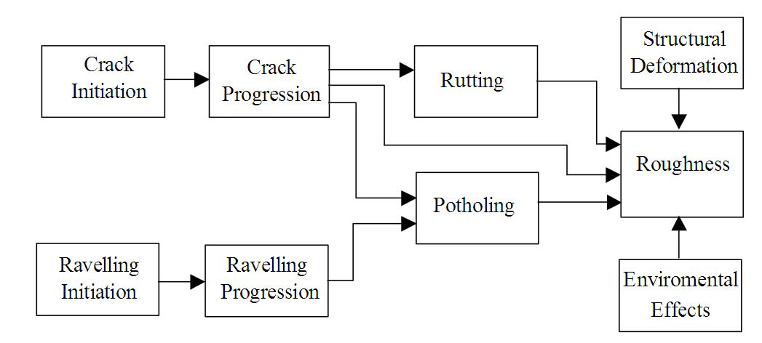
Pavement Distress Evolution
(Nakat and Madanat, 2010)

Slide 13
Methodology: Overview
Minimize the cracking threshold subject to an Emissions Budget
Dataset contains 999 segments selected from WSDOT pavements
Emission categories:
Agency (resurfacings)
User emissions
Use crack initiation and Crack progression model

Slide 14
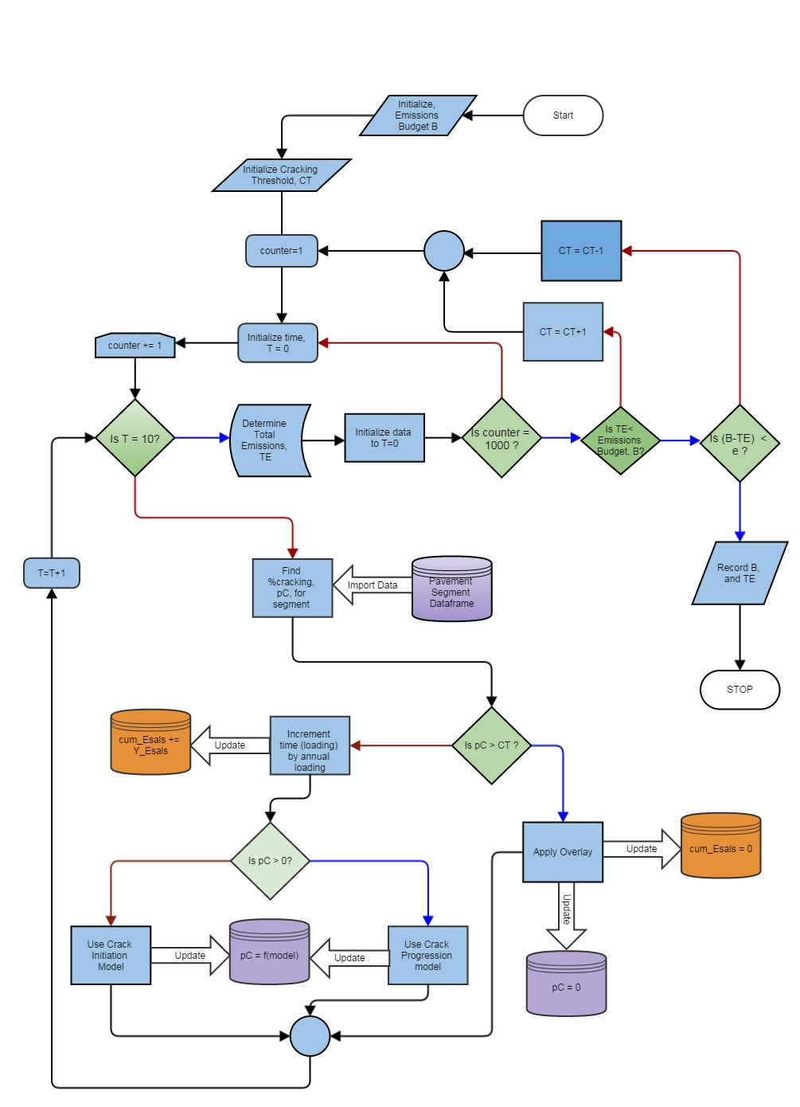
Methodology

Slide 15
Preliminary Results

Slide 16
Preliminary results

Slide 17
Preliminary Results
Average resurfacing frequency is 14 years
(WSDOT)

Slide 18
Overview of Results

Slide 19
Application..

Slide 20
Application ctnd..

Slide 21
Implications:
Informed decision making as per GWP of maintenance practices
More realistic predictions of pavement life
Fair assessment of budget requirements
Provides a basis for comparative analysis of worthwhile investments.

